Slide 1

Extra to the ordinary

Slide 2
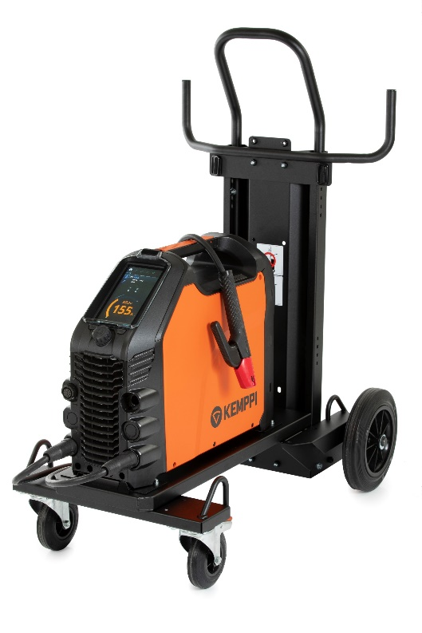
The new master of MMA welding
The new Master 315 sets new standards for the quality and usability in MMA welding.
Premium class MMA welding is characterized by reliable ignition, arc stability and suitability for all electrodes, including cellulosic.
Stylish, practical and robust, Master 315 absorbs the knocks of everyday welding life. Lightweight and compact, the Master 315 is constructed from tough injection molded plastic, featuring impact bridge protection structures, making it your reliable partner for workshop or site use.

Slide 3
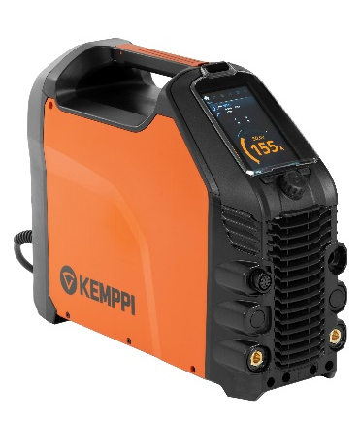
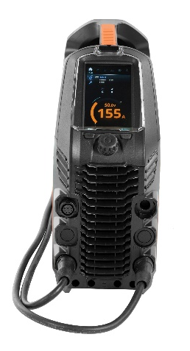
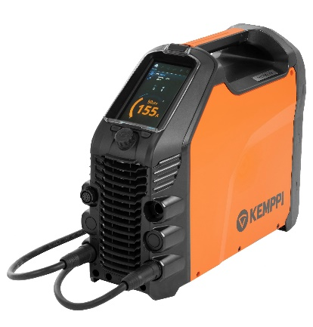
Master 315 power source options
Three 300 A options are available:
  Master 315 G
  Master 315 G (VRD locked on)
  Master 315 GM
Separate models for generator use, multi-voltage applications and Australian market/VRD.

Slide 4



Key benefits
WELD ASSIST
Take the guesswork out of
MMA parameter setting with
Weld Assist, lowering setup
speed by up to 60 % and
ensuring suitable parameter
setup the first time and every time.
HIGH QUALITY
MMA WELDING
Perfect welds are characterized
by a smooth, controlled
arc performance. Master 315
has the dynamic performance
to keep the arc under control,
including cellulosic electrodes.
WIRELESS
REMOTE CONTROL
Extend usability and eliminate hazards with the HR45 Bluetooth wireless remote control. Simple and safe power setting and memory channel selection up to 100 m from your workstation.

Slide 5
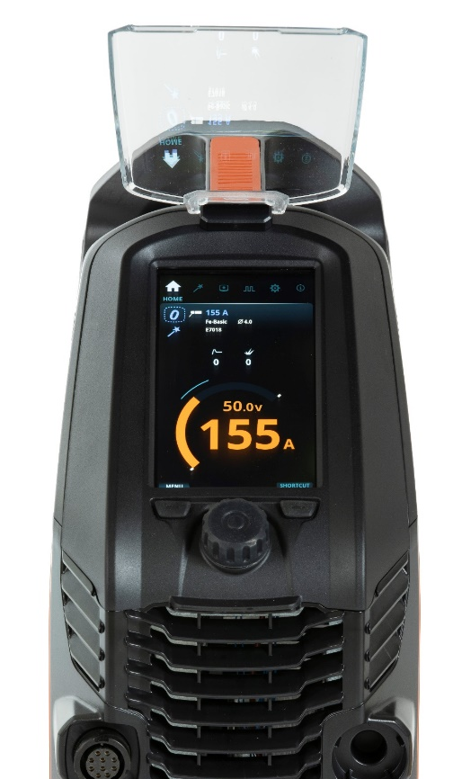


Simply a superb user experience
UI CONTROL PANEL
Equipped as standard with a full-color 7-inch TFT display, Master 315 defines the best user experience and accuracy for weld parameter setting and control. Protected by a 3 mm armor shield plate, the display is both robust and impact-resistant.
WELD ASSIST
Setting your machine the first time and every time with Weld Assist. Weld Assist sets your target range parameters fast, guiding every welder towards accurate, productive welding. Follow the simple on-screen steps, by selecting the electrode type, electrode size and joint configuration. Perfect for pWPS creation.

Slide 6
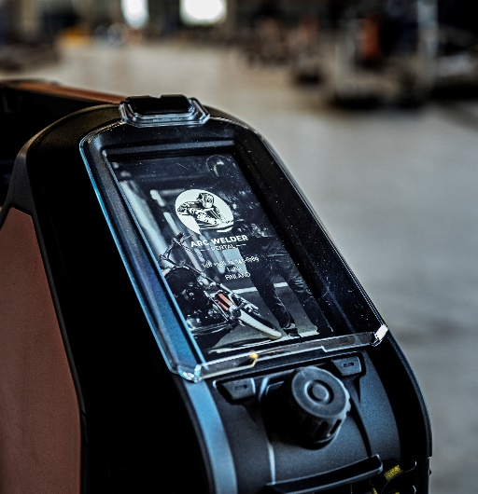



Premium features with practical value
PERSONALIZE
Upload your company logo, contact details or favorite image to the Master 315 screen saver. It’s simple and fast.
IMPACT BRIDGE
Master 315 is designed and constructed from strong, energy-absorbing, recyclable plastics, incorporating impact bridge structures that better protect the power source from the everyday knocks of welding life.
BLUETOOTH
The magic of cordless remote control. Select the HR45 Bluetooth remote control and enjoy wireless power or channel control from a distance of up to 100 meters. Eliminate the need for remote cable repairs and improve worksite safety by using HR45 Bluetooth wireless remote.

Slide 7



Enhanced welding
PULSED MMA
For selected applications, Pulsed MMA can lower the overall heat input, improve welding arc control and increase welding speed. Additional benefits of Pulsed MMA include excellent positional and root pass welding properties, cleaner welds and reduced heat deformation.
MEMORY CHANNELS
Master 315 includes 99 memory channels for your best parameter settings or WPS values to save and recall as required. Copy or delete and update as needed. It’s fast and simple.
WELD TIME CLOCK
Weld time clock allows you to record and compare welding jobs. Ideal for total weld cycle measurement, labor cost estimations and job data records. Weld time clock is simple and fast to reset.

Slide 8


Enhanced welding
ARCBREAK TECHNOLOGY
ARCbreak technology provides welding professionals a variable parameter setting to easily make and break the welding arc during MMA welding.
With better control of the weld pool and heat input, ARCbreak helps you avoid burn through, improves overall weld quality and increases tack welding speed. ARCbreak can be optimized through the Weld Assist menu for variable electrode types.
CELLULOSIC WELDING PERFORMANCE
Excellent cellulosic welding performance requires a big voltage reserve. Master 315 Weld Assist has a special welding program designed for cellulosic electrode welding, ensuring the unique arc force crucial for quality performance with cellulosic welding electrodes.

Slide 9
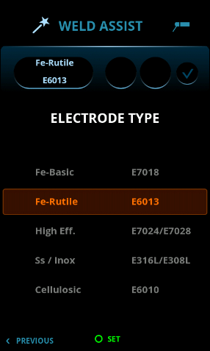
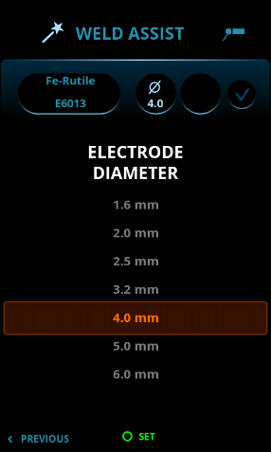
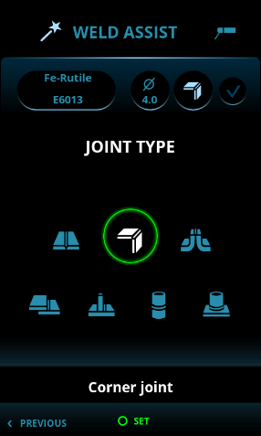
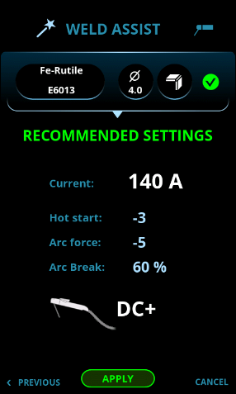
Weld Assist for MMA
Follow the simple on-screen steps
Select electrode type
Select electrode size
Select joint type
Weld Assist sets the best average parameters, guiding every welder towards accurate and productive welding.

Slide 10
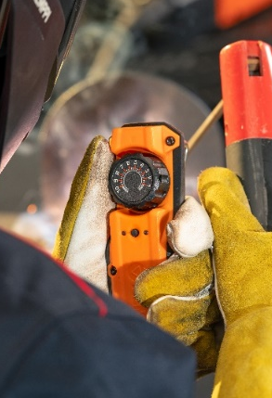
Wireless remote control
Experience the magic of cordless remote control with the HR45 hand remote.
Improves usability and worksite safety.
No cables to tangle or break, no trip hazards around the worksite, just simple and reliable power adjustment.
Bluetooth range up to 100 meters

Slide 11
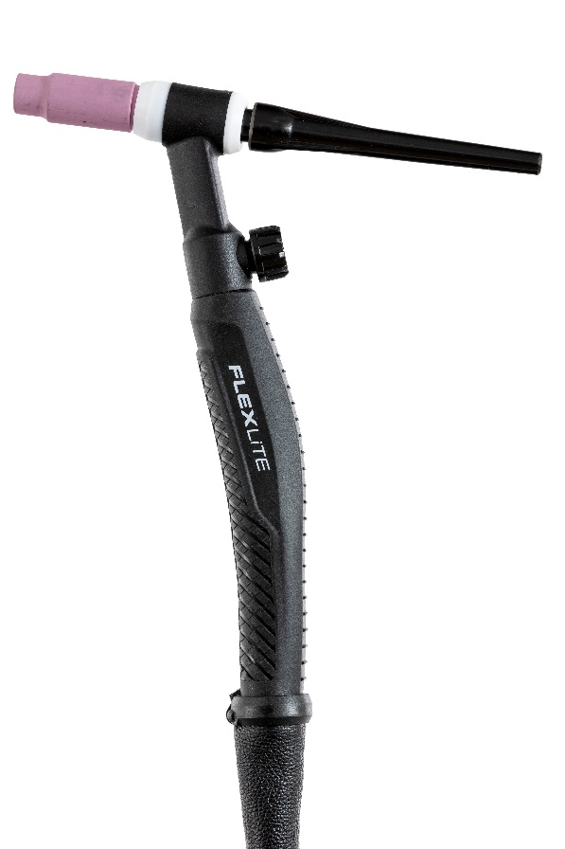
TIG welding with a Flexlite TX torch
Connect a Flexlite TX 223GVD134 torch and shielding gas, select suitable welding parameters for the TIG welding task and you're ready to ignite the welding arc. With a gentle touch of the tungsten electrode to the work-piece Master 315 provides an excellent power source for quality DC TIG welding.
Flexlite TX torches feature high-strength flexible molded handles for increased comfort and reduced welder fatigue.
Silicone rubber material gives a firm grip, and the innovative design reduces wrist loading, allowing you to concentrate on the perfect weld.

Slide 12
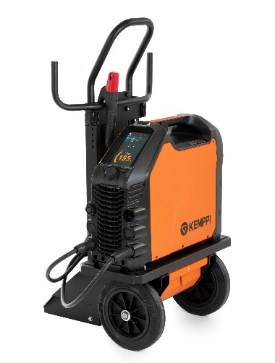
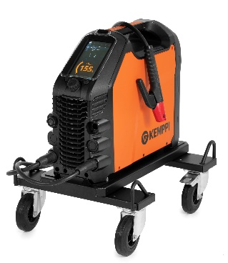

Transport units
Master 315 MMA welding machine can be combined with several Kemppi transport units
T25MT
P43MT
P45MT

